Slide 1
Answer to Jean Michel’s Questions
Miguel and Manuel

Slide 2
Hello Jean Michel,
Here we address all the interesting questions you have raised. In the next MINERVA meeting we will go into more details.
We use ppt so that we can easily attach figures and animations. Your questions are copy pasted in blue, the answers are in black.

Slide 3
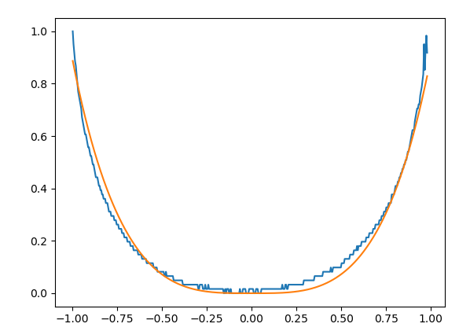
I see the channel width is just below the capillary length: I get a capillary length equal to 2,7 mm, so two capillary length makes 5,4 just above the 5 mm of the width. So, at rest, the whole shape of the meniscus should be two exponential decreasing from both walls toward the center to give an horizontal tangent at the middle: have you checked that ?
Indeed, the channel is slightly below two capillary length. We tested exponential-like fitting. In particular, we normalize the x axis in the range [-1,-1] and the y axis in the range [0,1]. Then, the exponential-like fitting should look like something of this form:
cosh(x^a/b)= (exp(x^a/b)-exp(x^a/b))/2
In general, this seems to work reasonably well also for dynamic conditions, but we do not easily recover the right contact angle out of such a fitting.
An example in dynamic conditions is shown on the right.
The red curve is the fitting, the blue curve is row data from the image processing. We are investigating this further for both the channel flow and the U-Tube configurations. We will present these results in the next meeting!
Normalized h
Normalized x

Slide 4
Have you measured the wetting angle at rest ?
We did! We tested using both XX and XX.
Normalized h
Normalized x

Slide 6
So, at rest, the whole shape of the meniscus should be two exponential decreasing from both walls toward the center to give an horizontal tangent at the middle: have you checked that ?
Have you measured the wetting angle at rest ?
Then, making a rise, we do not observe the expected parabolic shape, because, I guess, the Laplace pressure is still expected to play a big role; depending on the velocity, the meniscus shape is expected to be deformed trying to reach a parabolic shape in its middle, struggling with the walls asking for an exponential shape; no ?
Using my small rough phenomenological model of continuous galvanizing, I find that the location of inversion of curvature of the meniscus should be located about 800 µm for the walls when the velocity is 30 cm/sec
So, we are maybe observing that interaction between the wetting force in dynamic condition and the regular Poiseuille flow; what do you think ?
The sad point so far is that it looks quite difficult to observe the real shape of the interface close to the wall when the meniscus is moving up: how many pixels can we get from the wall to the “theoretical” minimum of the meniscus (so, at a distance of 800 µm) ? I understand that we have a shadow effect close to the walls that make the resolution not good enough; right ?
In the picture of the rising liquid, close to the end of the rise, when the mean velocity decreases, we see an inversion of the speed close to the wall, somewhat in the range of 800µm or less, maybe indicating that the speed there, becoming negative, well below the meniscus, is affected by the liquid “climbing along the wall”, and so some liquid, below the meniscus, has to refill the liquid closer to the wall that is still climbing up at a higher speed than the mean speed, when the maximum height is being approached; do you think it is the mechanism behind ? that would be fantastic !
Similarly, the vortices you see when the liquid falls look to be induced as well by the liquid being retained by the wall; I could not see the direction of rotation in those vortices; it could give some information useful to know; I guess it is clockwise on the left and anticlockwise on the right; right ?

